Slide 1
Car Claims for Insurance
Sandhya Nair
May 2021

Slide 2
Objective
Explore and visualize the data using Tableau
Generate a storyline from the analysis addressing a specific purpose and audience
Generate a set of insights and recommendations that will help the business

Slide 3
Story Line
A car insurance company wants to analyze the customer demographics and understand if the claim amount and frequency filed by the customers depend on customer demographics like age,gender, occupation etc. and vehicle usage and type.Also want to understand any other factors that will influence the claim amount.
After analyzing the factors, the company wants to decide for which group of customers the insurance rates should be increased.

Slide 4
Data Information
ID:Identification Variable
KIDSDRIV:Number of teenagers among the car owner's children who can drive a car.
BIRTH:Date of birth of the driver
HOMEKIDS:No of children the car owner has
YOJ:Years on Job. How many years has the owner of the car been working?
INCOME:Income of the driver
PARENT1:Is the car owner a Single Parent
HOME_VAL:Value of the house owned by the car owner
EDUCATION:Maximum Education level of the driver
OCCUPATION:Occupation of the driver
TRAVTIME:Time taken to get to work on
MSTATUS:Marital status of the car owner
GENDER:Gender of the driver
CAR_USE:Purpose of using the car

Slide 5
Data Information
BLUEBOOK:What is the worth of the car. Value of the Vehicle(in dollars)
CAR_TYPE:Car type
OLDCLAIM:Total claim (in past 5 years - in dollars)
CLM_FREQ:Number of claims (in past 5 years)
CLM_AMT:If car was in a crash, what is the currently claimed amount(in dollars)
CAR_AGE:Age of car
URBANICITY:Where the car is being driven primarily
There are 7647 rows and 21 columns

Slide 6
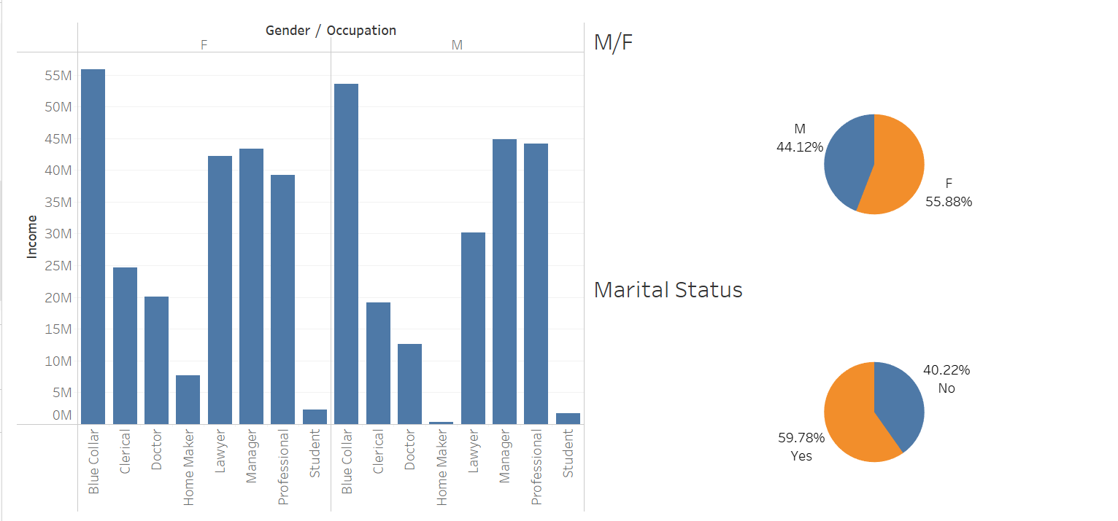
Customer Analysis-Gender,Occupation,Marital Status,Income
Analysis of gender/occupation with Income and Marital Status
Most of the customers have blue collar jobs for which Income is high
There are more Female customers than male customers
Majority of customers are married

Slide 7
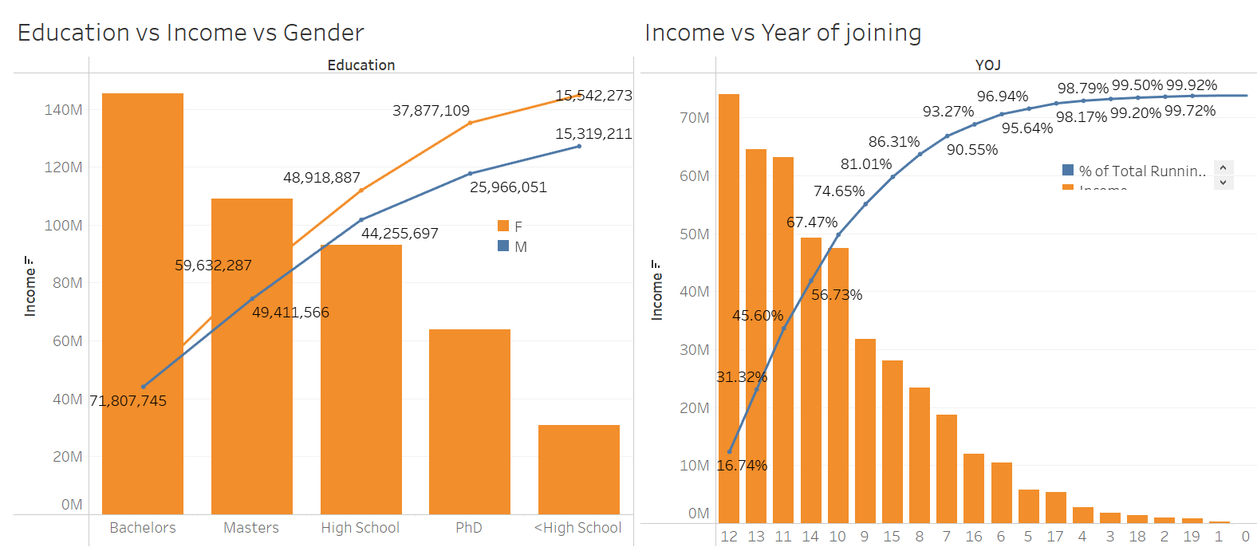
Customer Analysis -Income ,Education,Year of Joining
Analysis of Income,Education and Year of Joining
Customer Education & Income:Most of the customers have Bachelors degree and Income is higher for Female customers.Income is highest when on the job for 12 years followed by 12,11 and 14 years.

Slide 8
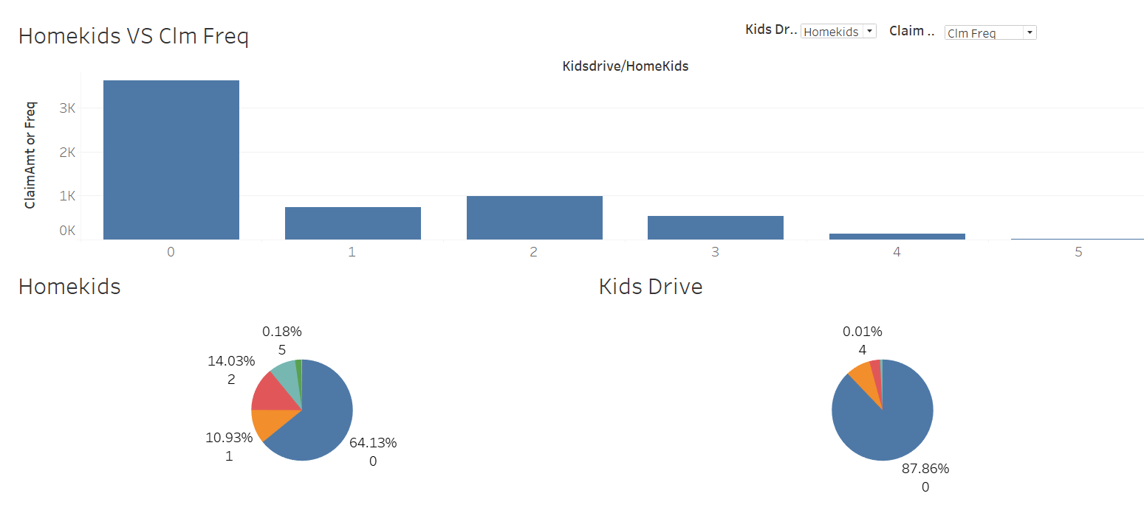
Kids Demographics
Kids Demographics
87.86% car owners have no teenagers that drive and 64.13% have no kids .
Claim frequency and amount is higher when there are no kids.

Slide 9
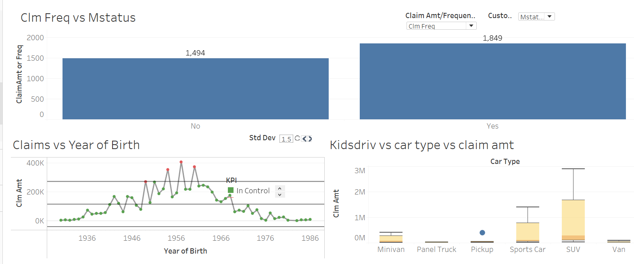
Claim Amount/Freq vs Customer Characteristics
Claim Amt/Freq vs Customer Characteristics
Claim Amt is high for customers in category Blue Collar,High School, Female ,Unmarried.
Claim Freq is high for Married customers.
Middle aged customers have higher claim amounts.

Slide 10
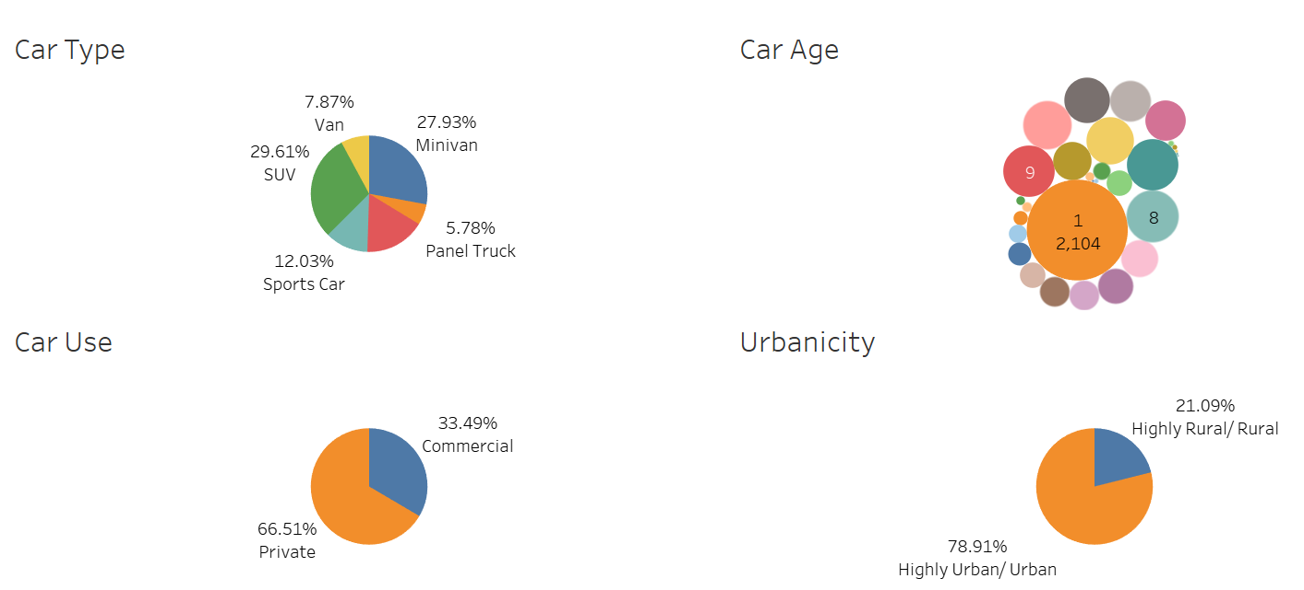
Vehicle Demographics
Car type,Car Age,Car Use,Urbanicity
Majority of cars are SUVs,have age of 1.
66.5% are private use vehicles.
78.9% of vehicles are used in highly urban/urban areas.

Slide 11
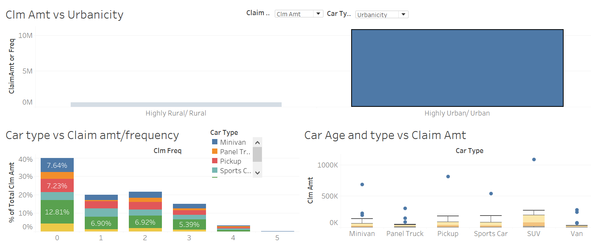
Claim Amount/Freq vs Vehicle Characteristics
Claim Amt is high for SUVs and in Urban areas and also for private use cars
The highest claim amount is for an SUV that has a car age of 1 year.

Slide 12
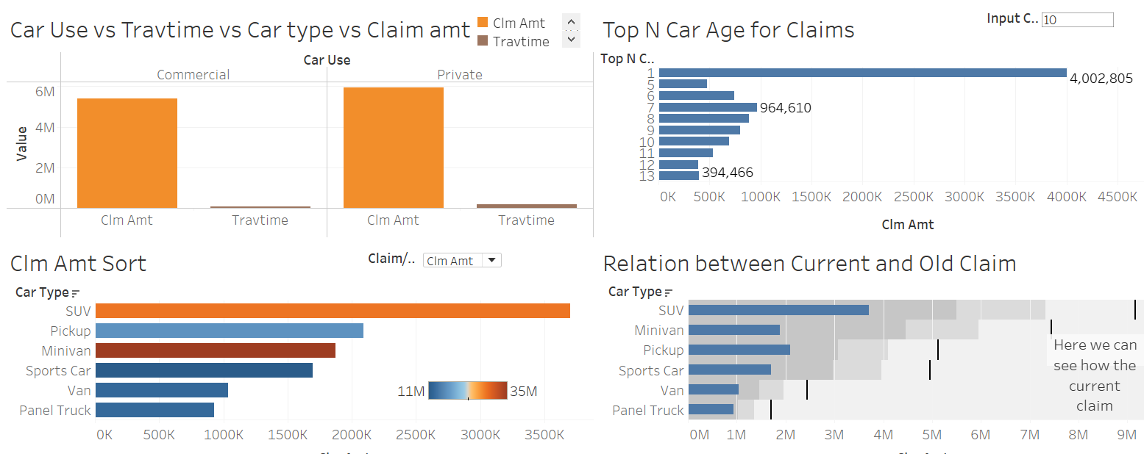
Travel time,car age ,Claim Sort
Travel time is more for Private vehicles.
Claim amount is high for SUV and pick up.
Blue book value is high for Minivan and SUV.
Car with Age of 1 year has highest claim at amount 4,002,805

Slide 13
Insights from Analysis
Customer Analysis & Claim Insights:
1.In terms of Gender, we have 55.8% Females and 44.1% Male customers.
2.59.7%Customers are Married and 40.2%customers are not married.
3.Majority of customers have blue collar jobs followed by Managers and professionals.
4.87.86% car owners have no teenagers that can drive and 64.13% have no kids owners do not have any teenagers who can drive.
5.Claim Amt is high for customers in category Blue Collar,High School, Female ,Unmarried.Claim Freq is high for Married customers.Middle aged customers have higher claim amounts.
6.Customer Education & Income:Most of the customers have Bachelors degree and Income is higher for Female customers.Income is highest when on the job for 12 years followed by 12,11 and 14 years.
7.87.86% car owners have no teenagers that drive and 64.13% have no kids .Claim frequency and amount is higher when there are no kids.

Slide 14
Insights from Analysis
Vehicle Analysis and Claim Insights
1.Majority of cars are SUVs,have age of 1
2.66.5% are private use vehicles.78.9% of vehicles are used in highly urban/urban areas.
3.Claim Amt is high for SUVs and in Urban areas. The highest claim amount is for an SUV that has a car age of 1 year.
4.Claim Amount is high in Highly Urban/Urban areas.
5.Claim Frequency and Amount is high for Private vehicles
6.Travel time is more for Private vehicles.Claim amount is high for SUV and pick up.
7.Blue book value is high for Minivan and SUV.Car with Age of 1 year has highest claim at amount 4,002,805

Slide 15
Business Recommendations
Based on our Analysis below are the top features that affect the claim amount and frequency
1.Location: Highly Urban/Urban areas tend to have higher claim amounts and frequency.Hence having customers from Urban areas means company can increase the insurance for the customer
2.Age:Claim amount is higher for middle aged customers and hence insurance amount will be higher in those category.
3.Gender:Claim amount and frequency tend to higher in females so insurance rates can increased for female customers
4.Marital Status:Claim amount is higher for non married customers and insurance rates should be higher for them
5.Vehicle type:SUVs and Minivans tend to have higher claims hence insurance rates can be increased for such vehicles.

Slide 16
Business Recommendations
6.Vehicle Use:Private use vehicles are the ones having higher claims and insurance rates can be increased for those.
7.Kids:Customers having no kids have higher claim amounts and customers from that category should have higher insurance rates.

Slide 17
Tableau Dashboard URL
https://public.tableau.com/profile/sandhya.nair5455#!/vizhome/Car_ClaimsforInsurance/CarClaimsforInsurance?publish=yes

